Slide 1
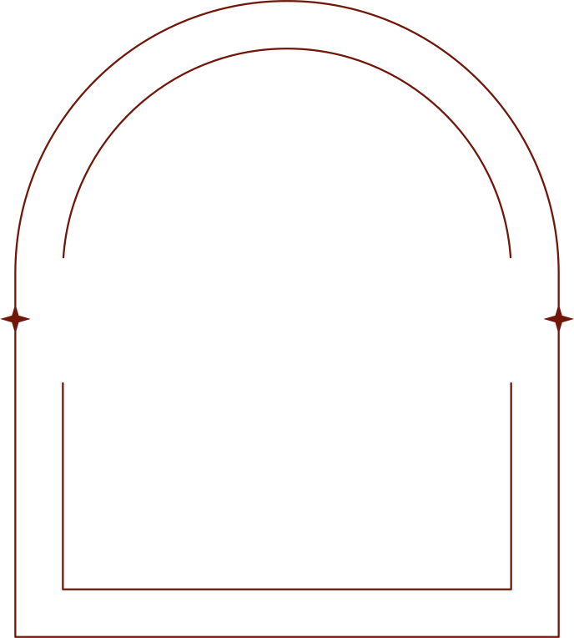

HIREUP
Nafisa Tasnim
220042114
Nishat Tasnim
220042124
Mrittika Jahan
220042150
1

Slide 2
OVERVIEW
HireUp:
Digitalize various aspects of job field.
Console based Java application.
Bring together both job applicants and job providers in a single platform.
2

Slide 3
MOTIVATION
Job searching is tough due to overpopulation and limited connections, making it hard for applicants and companies to find the right match.
HireUp streamlines the job search and hiring process by connecting job seekers with employers in a centralized platform.
It simplifies hiring for employers, improves access to opportunities for candidates and offers job recommendation.
3

Slide 4





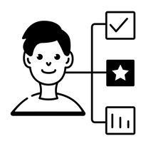
FEATURES
APPLICANT:
Job
Preference
Registration
Job
Application
Resume
Generation
Job
Status
4

Slide 5



FEATURES
JOB PROVIDER:
Selection
Job
Circular
View
Shortlist
5

Slide 6



FEATURES
ADMIN:
Account
Handling
View User
Information
Verification
6

Slide 7



TIMELINE
Initialization & System Architecture Finalization
Knowledge Gathering
Class Diagram & Design of Database Schema
User Creation, Registration & Verification
Resume Generation & Personalized Job Search
Job Circular Management
Job Application Update
Testing & Debugging
Finalization
W1 | W2 | W3 | W4 | W5 | W6 | W7 | W8 | W9 | W10 | W11 | W12 | W13 | W14
7
Finished
In Progress
Pending
Figure: TIMELINE

Slide 8




TOOLS & TECHNOLOGY
8

Slide 9


THANK YOU
9

